Slide 1


Ferndale Climate Policy Advisory Team
Meeting One | Thursday, January 30th, 2025

Slide 2
AGENDA
Goal: To provide an overview of the development of the GHG Emission Reduction Element and begin developing a vision statement.
Time | Agenda Topic
2:00 - 2:15 p.m. | Welcome and Introductions City staff will welcome CPAT members and facilitate introductions.
2:15 - 2:35 p.m. | Overview of GHG Emission Reduction Element Introduction to HB1181 Approach to development GHG Emission Reduction Element CPAT role in development of GHG Emission Reduction Element and meeting schedule and purpose overview
2:35 - 2:55 p.m. | Vision statement The consultant team will facilitate a visioning process for the GHG Emission Reduction Element. Members will write their own statement and then enter small group discussions prior to a full group discussion
2:55 - 3:00 p.m. | Review next steps

Slide 3
INTRODUCTIONS
PLANNING TEAM
CPAT MEMBERS
Name | Role
Michael Cerbone | Ferndale Community Development Director
Kyla Boswell | Ferndale Assistant Planner
Vivian Ericson | MFA Facilitator
Natalie Sacker | MFA Planner
Name | Role
Lauren Clemens | Whatcom County Climate Action Manager
Hayden Richardson | Whatcom Transportation Authority
David Strich | WSDOT Senior Multimodal Planner
Kurt Baumgarten | Senior Planner Port of Bellingham
Eric Weden | Owner of Weden Engineering
Ryan O'Larey | City Councilor
Manuel Reta | Member of Hispanic Chamber of Commerce and Local Business Owner

Slide 4
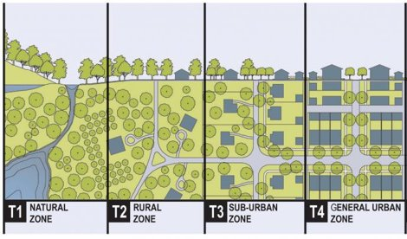
BACKGROUND: GROWTH MANAGEMENT ACT
Adopted in 1990
Requires long-range planning
Intent:
  Limit sprawl
  Direct growth where services exist
  Protect the state’s natural resources and agricultural land
  Encourages land uses to reduce vehicle car emissions
We start by understanding your vision, mission, goals and objectives. It’s about what you want to accomplish. Whether you are a heavy industry, private business, public agency, or a mission-driven nonprofit, we are committed to achieving your desired results and outcomes.
More protected under GMA from development

Slide 5
HOW GMA AND COMPREHENSIVE PLANS RELATE
Growth Management Act (GMA)
Whatcom County Countywide Planning Policies (CPPs)
Ferndale Comprehensive Plan
Local comprehensive plans help implement the intent of the GMA
Plans include policies that benefit the community, municipality, and the region
GMA requires certain chapters, called “elements” in the plan, as well as regional cooperation and consistency
Department of Commerce provides guidance, funding, and certifies the plan according to state law
We start by understanding your vision, mission, goals and objectives. It’s about what you want to accomplish. Whether you are a heavy industry, private business, public agency, or a mission-driven nonprofit, we are committed to achieving your desired results and outcomes.

Slide 6
WHAT IS A COMPREHENSIVE PLAN?
A guiding document that:
  Establishes the community’s vision for 20 years
  Engages the community through the update process
  Compares what exists with what is anticipated and possible
  Includes background information and data to support policy direction
  Includes specific elements with policy language intended to achieve the community vision and to manage anticipated growth
  Guides the Planning Department and City Council toward implementation, development regulations, and funding
We start by understanding your vision, mission, goals and objectives. It’s about what you want to accomplish. Whether you are a heavy industry, private business, public agency, or a mission-driven nonprofit, we are committed to achieving your desired results and outcomes.

Slide 7
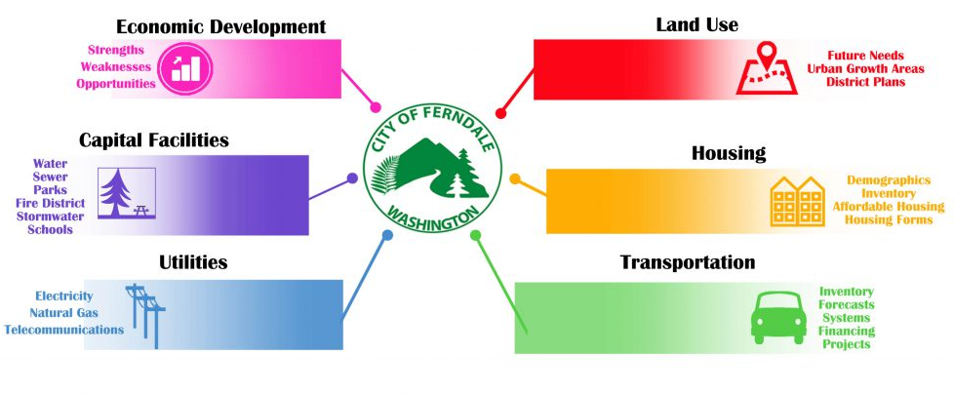
FERNDALE’S COMPREHENSIVE PLAN
We start by understanding your vision, mission, goals and objectives. It’s about what you want to accomplish. Whether you are a heavy industry, private business, public agency, or a mission-driven nonprofit, we are committed to achieving your desired results and outcomes.

Slide 8
WHAT IS THE CLIMATE ELEMENT?
2023 legislation (HB1181) added a climate goal to the Growth Management Act (GMA).
Requires local comprehensive plans to include a climate element.
Climate elements must:
  Maximize economic, environmental, and social co-benefits.
  Prioritize environmental justice to avoid worsening health disparities.
  Can be a standalone chapter or integrated into housing, transportation, and land use chapters.
We start by understanding your vision, mission, goals and objectives. It’s about what you want to accomplish. Whether you are a heavy industry, private business, public agency, or a mission-driven nonprofit, we are committed to achieving your desired results and outcomes.

Slide 9
GHG Inventory
Tribal Engagement
CPAT
VISION, GOALS AND STRATEGIES
Public Engagement
HOW WILL THE GHG REDUCTION ELEMENT BE DEVELOPED?
FEEDBACK
FEEDBACK
DRAFT ELEMENT & POLICY CHANGES
FINAL ELEMENT & POLICY CHANGES
ADOPTION
Notes:
Different input from groups to know what’s important, balance different needs to come up with what updates are needed.

Slide 10
HOW WILL THE GHG GOALS AND POLICIES BE DEVELOPED?
January
February
March
April
May
June
Tribal Engagement
CPAT #1
CPAT #2
CPAT #3
CPAT #4
CPAT #5
Online Open House and Survey
GHG Data Collection
GHG Data Analysis
GHG Inventory Report

Slide 11
ROLE OF THE CPAT
The CPAT brings technical expertise and community knowledge.
Includes activities such as:
  Reviewing and discussing planning topics and draft materials at Advisory Group meetings
  Provide feedback on the comprehensive plan update to the Planning Commission or City Council
  Sharing updates on the plan update with community groups and networks
  Suggesting ways to improve outreach and engagement
We start by understanding your vision, mission, goals and objectives. It’s about what you want to accomplish. Whether you are a heavy industry, private business, public agency, or a mission-driven nonprofit, we are committed to achieving your desired results and outcomes.

Slide 12
HOW WILL THE CPAT BE ENGAGED?
January 30: Overview and Visioning
Introductions
Overview of GHG Reduction Element and Development
February: GHG Emissions Background and SWOT
Overview of GHG Inventory Process
Strengths, Weaknesses, Opportunities and Threats Analysis for adaptation and mitigation in Ferndale: 1) Built environment; 2) Natural and working lands; and, Community members
March: Review Potential Goals and Policies
Members will be provided with a list of potential goals on policies based on SWOT in advance
Early May: Review Survey Results and GHG Inventory Results
Discussion of potential goals and policies
Visioning
CPAT will provide feedback on goals and policies
Results of public outreach and GHG Inventory and high-level analysis of potential policy goals and strategies
June: Review of Refined Goals and Policies
CPAT members will be provided with updated vision, goals, and policies in advance of the meeting with expectation they will provide feedback
Discuss feedback received from the CPAT on the refined vision, goals, and policies
We start by understanding your vision, mission, goals and objectives. It’s about what you want to accomplish. Whether you are a heavy industry, private business, public agency, or a mission-driven nonprofit, we are committed to achieving your desired results and outcomes.

Slide 13
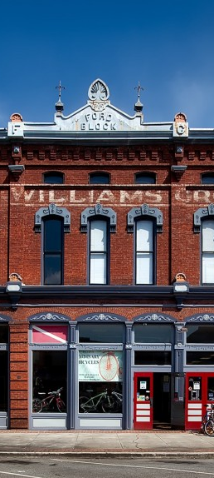
VISION STATEMENT.
INVIDUAL REFLECTION
Take 3 minutes to write down a vision statement for Ferndale when it comes to climate change. Where do you want Ferndale to be in 20 years?
PAIRED DISCUSSION
Talk in pairs for 3 minutes about your vision statement.
SMALL GROUP
Talk in small groups for 6 minutes about your vision statement.
FULL GROUP DISCUSSION
Small groups will share highlights from their conversations.
Notes:
Early in the local planning process, jurisdictions often begin by creating a vision statement. In this context, your climate policy advisory team should draft a statement about the social, economic, and environmental places, traditions, and values that matter most to your community members. Articulate why and how your community members want to sustain them in the face of a changing climate. The vision statement should include guiding principles or values consistent with those your jurisdiction has articulated already for the comprehensive plan and/or the periodic update in general.

Slide 14

SAMPLE VISION STATEMENTS.
Pullman:
To be innovative, a champion of climate work, and incorporate a variety of City departments in climate work
Port Angeles:
Integrate climate resilience throughout the comprehensive plan, with a focus on hazard mitigation,
demonstrate commitment to the pilot program,
use the results of this work to update land-use maps and other City goals
Woodland:
City staff and Council education on climate impacts, incorporate climate into local decision making
This Photo by Unknown Author is licensed under CC BY
Notes:
These are from Appendix H (p. 106) of the Intermediate Planning Guidance, where these are labeled “Guiding principles”.
“Early in the local planning process, jurisdictions often begin by creating a vision statement. In this context, your climate policy advisory team should draft a statement about the social, economic, and environmental places, traditions, and values that matter most to your community members. Articulate why and how your community members want to sustain them in the face of a changing climate. The vision statement should include guiding principles or values consistent with those your jurisdiction has articulated already for the comprehensive plan and/or the periodic update in general. [see examples in Appendix H]”

Slide 15
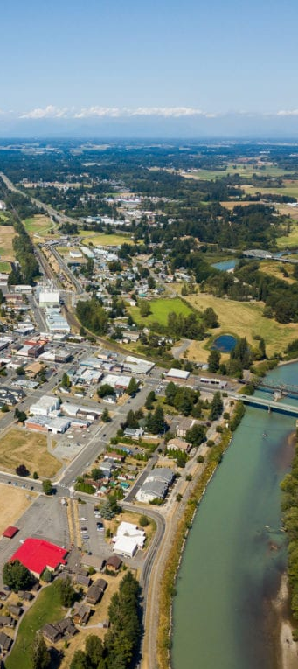
NEXT STEPS.
SCHEDULE MEETING 2
The next meeting will be 90 minutes, in-person, on GHG Emissions and SWOT Analysis, sometime in February
FINALIZE VISION STATEMENT
The vision statement will be finalized and submitted to Commerce
SCHEDULE MEETINGS 3-5
The remaining meetings will be in March, May, and June
Notes:
Photo credit- Visit Bellingham

Slide 16
QUESTIONS?

