Slide 1


Ferndale Climate Policy Advisory Team
Meeting Two | Thursday, February 27th, 2025

Slide 2
AGENDA
Goal: To provide an overview of the development of the GHG Emission Reduction Element and begin developing a vision statement.
Time | Agenda Topic
2:00 - 2:05 p.m. | Welcome and Meeting Purpose City staff will welcome CPAT members and introduce the meeting purpose
2:05 - 2:20 p.m. | Overview of GHG Inventory Effort High-level presentation of GHG inventory process Question and answer
2:20 – 3:20 p.m. | SWOT (Strengths, Weaknesses, Opportunities, Threats) Analysis for Climate Change and the City of Ferndale
3:20 - 3:30 p.m. | Review highlights of discussion and next steps

Slide 3
GHG Inventory Purpose
2023 legislation (HB 1181) added a climate goal to the Growth Management Act (GMA)
Requires local comprehensive plans to include a climate element
GHG reduction sub-element (11 fastest-growing counties and cities within)
Climate resilience sub-element
The GHG inventory will:
Estimate the magnitude of current emissions
Identify largest emission sources
Inform the selection of goals and policies for Ferndale’s GHG reduction sub-element
We start by understanding your vision, mission, goals and objectives. It’s about what you want to accomplish. Whether you are a heavy industry, private business, public agency, or a mission-driven nonprofit, we are committed to achieving your desired results and outcomes.
Notes:
House Bill 1181, signed into law in 2023, requires Washington cities and counties to add a Climate Element to their Comprehensive Plans to increase resilience and reduce greenhouse gas (GHG) emissions. For 11 counties (including Whatcom County) and the cities within, creating a GHG emissions sub-element is a mandatory part of next Comprehensive Plan update. This GHG emissions inventory supports the City’s comprehensive planning by identifying and estimating the magnitude of current emissions, which is a key step in understanding the City’s largest emissions sources and finding areas where reductions can be made.

Slide 4
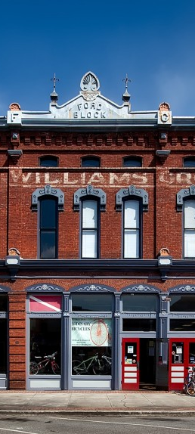
GHG Inventory Approach
Replicability and Transparency
Inventories can be conducted for Ferndale in future years using the same methods and compared to the baseline inventory (2023).
Consistency
Inventories can be compared with the 2022 Whatcom County GHG Emissions Analysis.
Accuracy
Relevant emission sources are included, and locally specific data are used where available.

Slide 5
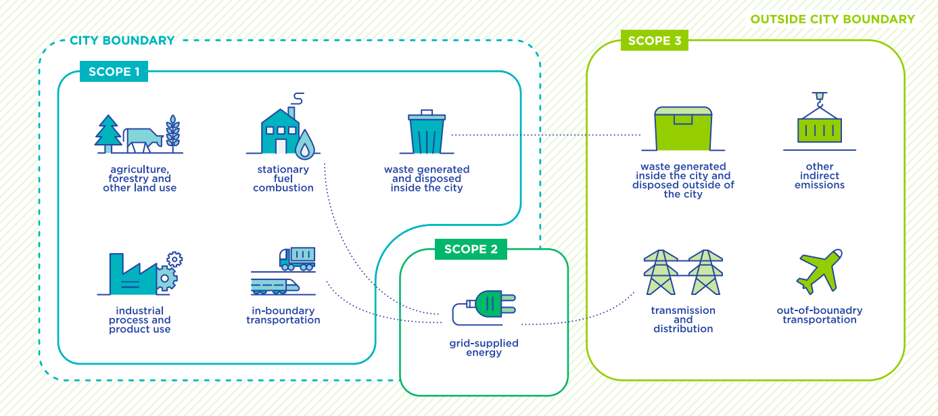
Methods
Protocols:
ICLEI U.S. Community Protocol
ICLEI U.S. Local Government Operations Protocol
Gases included:
Carbon dioxide (CO₂)
Methane (CH₄)
Nitrous oxide (N₂O)
Hydrofluorocarbons (HFCs)
Perfluorocarbons (PFCs)
Sulfur hexafluoride (SF₆)
We start by understanding your vision, mission, goals and objectives. It’s about what you want to accomplish. Whether you are a heavy industry, private business, public agency, or a mission-driven nonprofit, we are committed to achieving your desired results and outcomes.
Notes:
Scope 1 = Emissions released directly within boundary. Burning the fuel and releasing emissions immediately (e.g., natural gas use in homes, transportation)
Most of the sources included in Ferndale’s inventory are Scope 1. More details on the next two slides.
Scope 2 = Grid supplied electricity (also includes steam, heating, cooling). Emissions may not be produced in Ferndale, but electricity is consumed in Ferndale. These would be PSE’s Scope 1 emissions.
Scope 3 = Emissions released outside city boundary but related to city activities. Example in this inventory is waste produced in Ferndale is trucked to

Slide 6
Emission Sources and Data
Category | Inventory Item | Sectors | Data Source(s) | Scope | Data Specificity
Building Energy | Natural Gas | Residential Commercial Industrial | Cascade Natural Gas | 1 | Local data
 | Propane | Residential Commercial Industrial | U.S. Energy Information Administration U.S. Census Bureau WA State Employment Security Department | 1 | Scaled regional/state data
 | Fuel Oil | Commercial Industrial | U.S. Energy Information Administration U.S. Census Bureau WA State Employment Security Department | 1 | Scaled regional/state data
 | Electricity | Residential Commercial Industrial | Puget Sound Energy | 2 | Local data
Misc. | Refrigerants | N/A | U.S. EPA | 1 | Scaled national data
Misc. | Land use/cover | N/A | ICLEI Land Emissions and Removals Navigator Tool | 1 | Local data
We start by understanding your vision, mission, goals and objectives. It’s about what you want to accomplish. Whether you are a heavy industry, private business, public agency, or a mission-driven nonprofit, we are committed to achieving your desired results and outcomes.
Notes:
When we were scoping GHG inventory with Mike and Kyla, we went through 2022 Whatcom County GHG emissions analysis from Commerce and looked at included emission sources, data sources, and local relevance. Included/excluded emission sources.

Slide 7
Emission Sources and Data
Category | Inventory Item | Data Source(s) | Scope | Data Specificity
Transportation | On-Road Emissions (VMT) | WSDOT or Whatcom Council of Governments | 1 | Local data
 | Transit (WTA Route 27) | Whatcom Transportation Authority | 1 | Local data
Wastewater | Wastewater Treatment | City of Ferndale ICLEI Local Government Operations Protocol | 1 | Local data
Waste | Solid Waste | Sanitary Service Company WA Department of Ecology U.S. EPA | 3 | Local data
 | Compost | Sanitary Service Company WA Department of Ecology U.S. EPA | 3 | Local data
We start by understanding your vision, mission, goals and objectives. It’s about what you want to accomplish. Whether you are a heavy industry, private business, public agency, or a mission-driven nonprofit, we are committed to achieving your desired results and outcomes.
Notes:
What is in Whatcom County inventory that won’t be included in Ferndale inventory?
*

Slide 8
SWOT ANALYSIS: A way to understand where you are and where you could go.
STRENGTHS
What is the City doing well when it comes to Climate Change? What does the City have that supports the work it’s doing well?
WEAKNESSES
Where could the City improve? What might be preventing the City from improving?
OPPORTUNITIES
What is happening outside of the City that could help the City be successful?
THREATS
What is happening outside of the City that could make it harder for the City to be successful?
Notes:
Internal factors: Strengths and weaknesses are internal factors within an organization. Examples include people, culture, budget, policies, programs, and relationships.
External factors: Opportunities and threats are external factors in the market or environment that can affect the organization. Examples include emerging markets, legislation, technology, environmental risks, and economic issues.
Strengths:
1. What do we do best?
2. What unique knowledge, talent, or resources do we have?
3. What advantages do we have?
4. What do other people say we do well?
5. What resources do we have available?
6. What is our greatest achievement?
Weaknesses:
1. What could we improve?
2. What knowledge, talent, skills and/or resources are we lacking?
3. What disadvantages do we have?
4. What do other people say we don’t do well?
5. In what areas do we need more training?
6. What customer complaints have we had about our services?
Opportunities:
1. How can we turn our strengths into opportunities?
2. How can we turn our weaknesses into opportunities?
3. Is there a need in our agency that no one is meeting?
4. What could we do today that isn’t being done?
5. How is our field changing? How can we take advantage of those changes?
6. Who could we support? How could we support them?
Threats:
1. What obstacles do we face?
2. Could any of our weaknesses prevent our unit from meeting our goals?
3. Who and/or what might cause us problems in the future? How?
4. Are there any standards, policies, and/or legislation changing that might negatively impact us?
5. Are we competing with others to provide service?
6. Are there changes in our field or in technology that could threaten our success?

Slide 9
HOW WILL WE DO THE SWOT TOGETHER?
INDIVIDUAL EXERCISE.
Write down what you think are the strengths, weaknesses, opportunities and threats on sticky notes.
GROUP DISCUSSION
Discuss themes and ideas.
5 MIN BREAK

Slide 10
A LOOK AHEAD.
March: Review Potential Goals and Policies
Members will be provided with a list of potential goals on policies based on SWOT in advance
Early May: Review Survey Results and GHG Inventory Results
Discussion of potential goals and policies
CPAT will provide feedback on goals and policies
Results of public outreach and GHG Inventory and high-level analysis of potential policy goals and strategies
June: Review of Refined Goals and Policies
CPAT members will be provided with updated vision, goals, and policies in advance of the meeting with expectation they will provide feedback
Discuss feedback received from the CPAT on the refined vision, goals, and policies
We start by understanding your vision, mission, goals and objectives. It’s about what you want to accomplish. Whether you are a heavy industry, private business, public agency, or a mission-driven nonprofit, we are committed to achieving your desired results and outcomes.

Slide 11
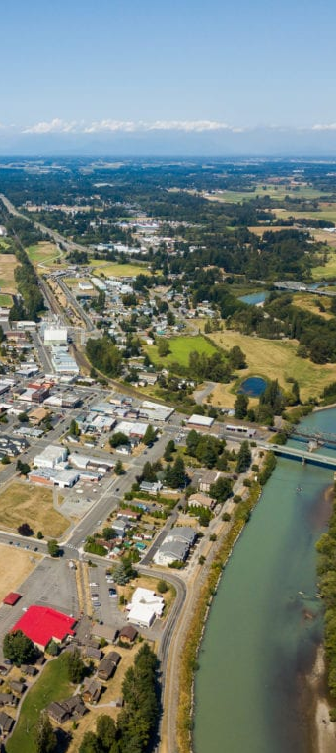
NEXT STEPS.
SCHEDULE MEETINGS 3-5
The remaining meetings will be in March, May, and June. Natalie will send out potential dates the first week of March.
POTENTIAL GOALS AND POLICIES
The consultant team and City will use the SWOT analysis to generate an initial list of potential goals and policies for the GHG reduction subelement.
CPAT REVIEW OF GOALS AND POLICIES
The CPAT will review the initial list of goals and policies in advance of the next meeting where we will have an in-depth discussion.
Notes:
Photo credit- Visit Bellingham

Slide 12
QUESTIONS?

